Slide 1
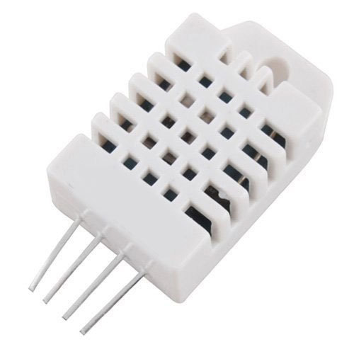
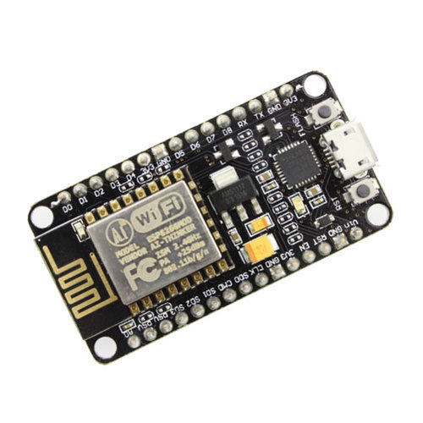
Original Plan:
Use Esp8266 and DHT22 (Digital, Humidity, Termal version 22) to send the Humidity to Slack and find leaks.

Slide 2
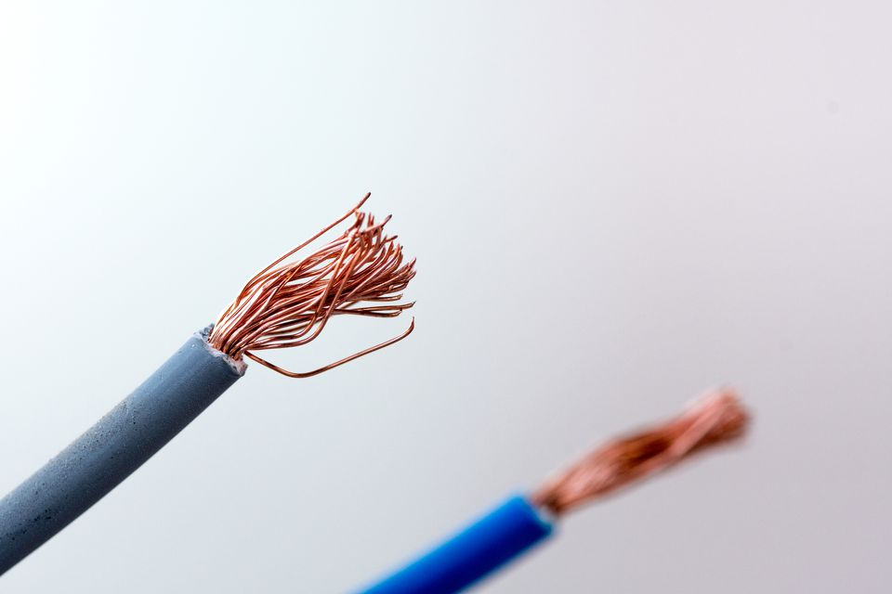
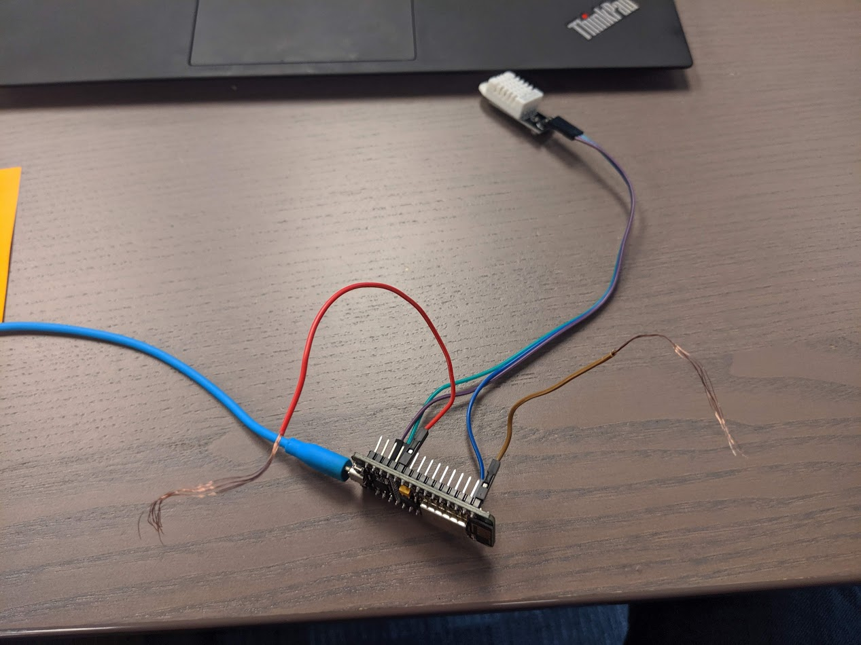
Homemade Sensor:
2 naked wires sending voltage to Slack

Slide 3
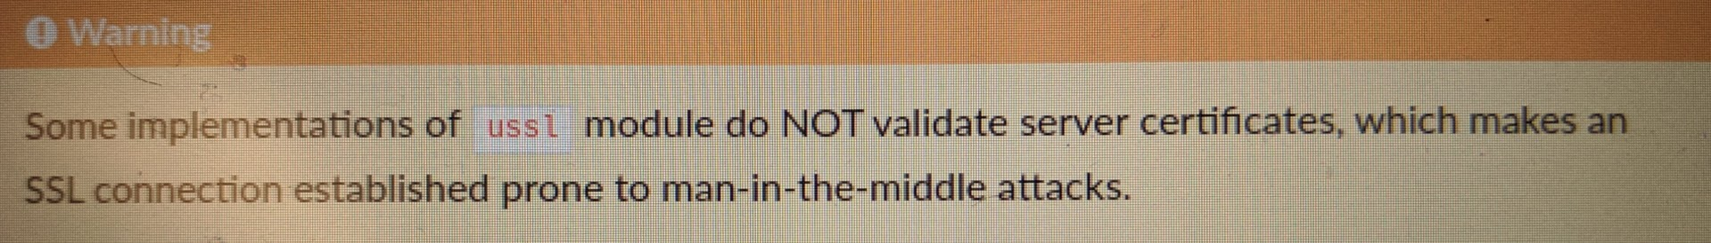
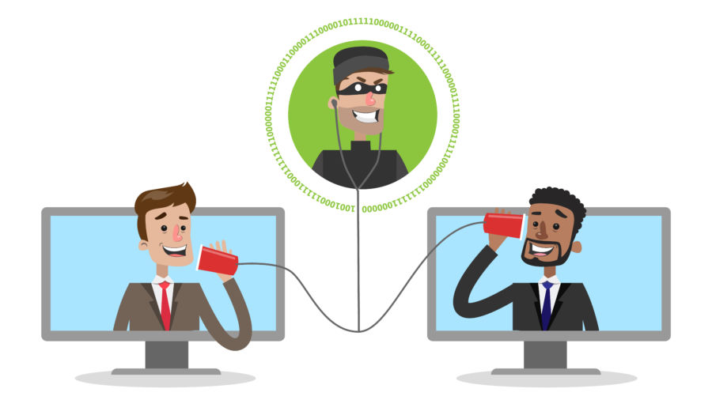
No Certificate Validation:

Slide 4

Signing Device Messages:
1. device sends message + sha1(message + device_secret)
2. server recalculates signature
3. server compares signatures
4. I could use hmac (as in books) but it's not available

Slide 5
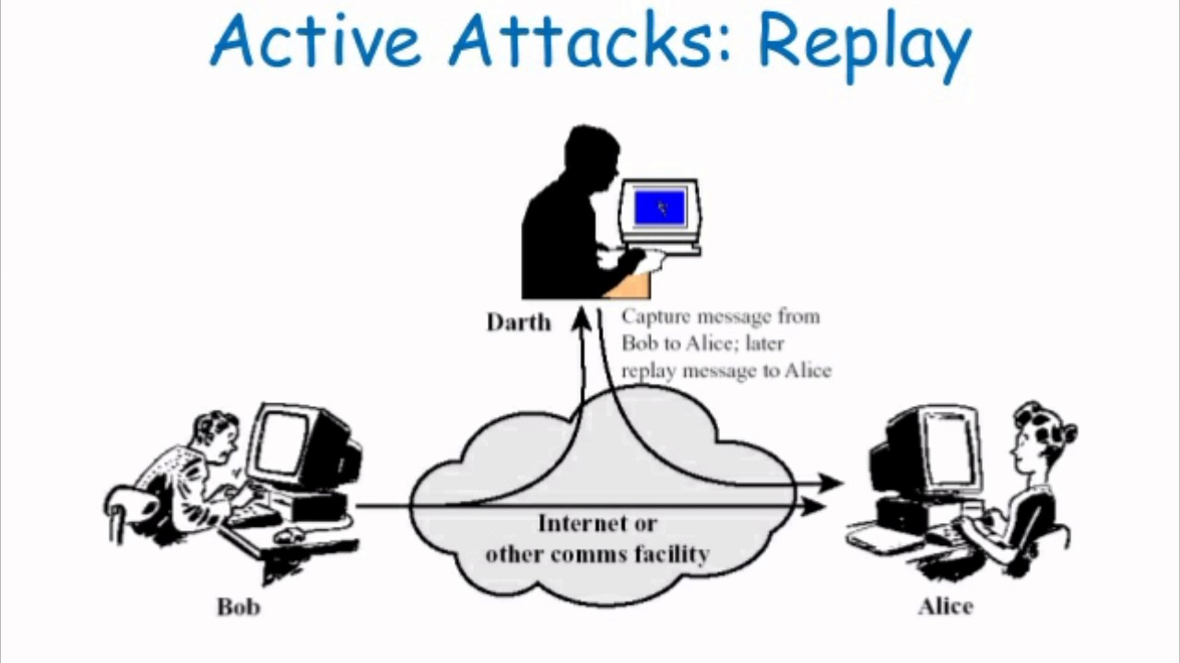
Replay Attack:
MITM records messages and then resends messages.
Ways to counter:
1. server generates random ticket once in a minute
2. client includes this ticket in the message and signature
Or use a timestamp but esp8266 does not support time.

Slide 6
Future Plans:
1. add support for more sensors
2. add support for more devices
3. power saving mode

Slide 7
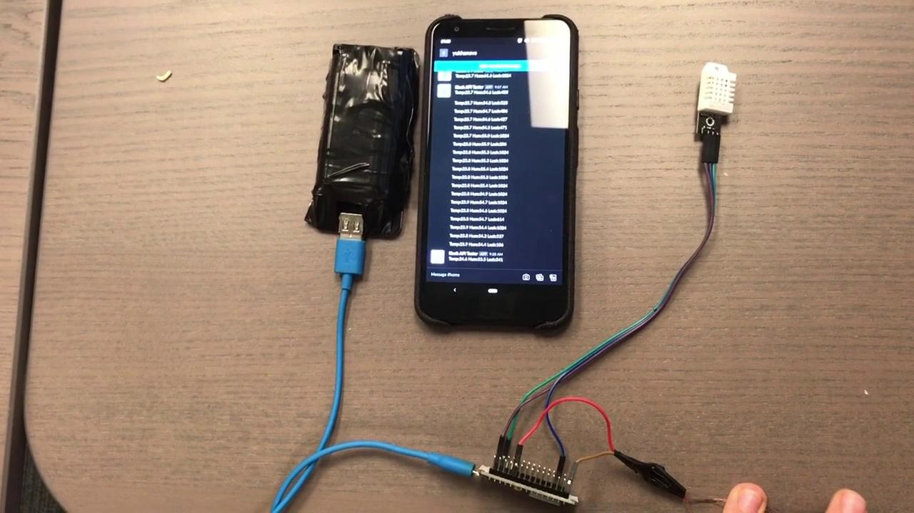
Video:

